Slide 1
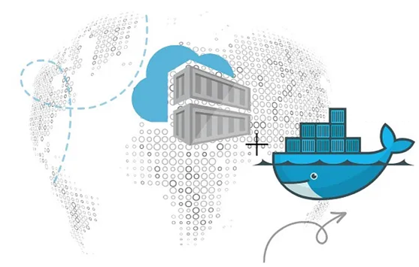

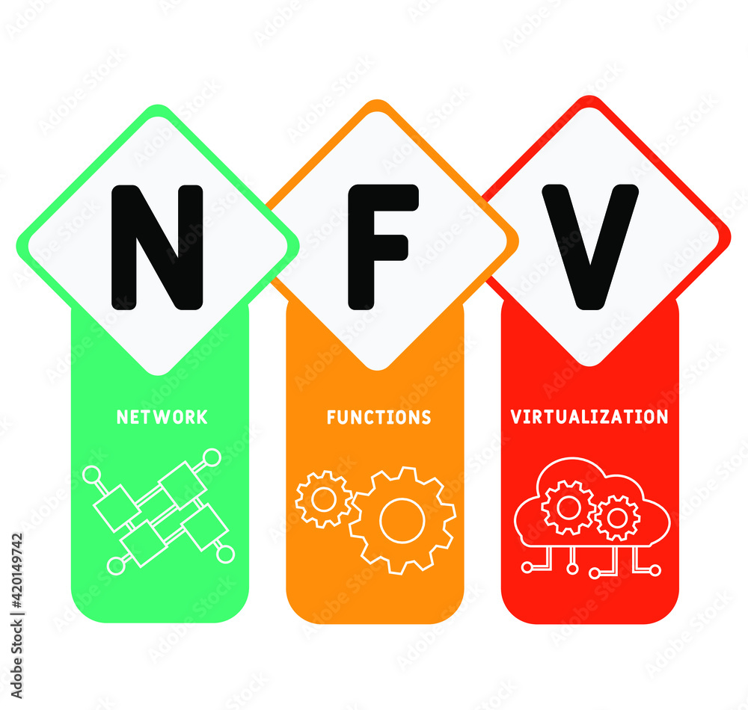
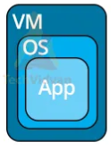
PDS
Computer Vision
AWS Map, AWS Cloud Architecture
& AWS Services
https://github.com/siagianp
https://www.youtube.com/@AmelOline/videos
Open TofU-IaC
https://github.com/amelcharolinesgn2/IoT_simulator-mqtt-NodeRed
https://github.com/amelcharolinesgn2/Cloud-Infrastructures
Notes:
https://roadmap.sh/aws
https://roadmap.sh/aws
https://aws.amazon.com/what-is-cloud-computing/
https://www.ibm.com/think/topics/cloud-computing
3. https://www.ibm.com/topics/cloud-computing
4. https://csrc.nist.gov/pubs/sp/800/145/final
https://csrc.nist.gov/pubs/sp/800/145/final
https://docs.openstack.org/liberty/install-guide-rdo/overview.html

Slide 2
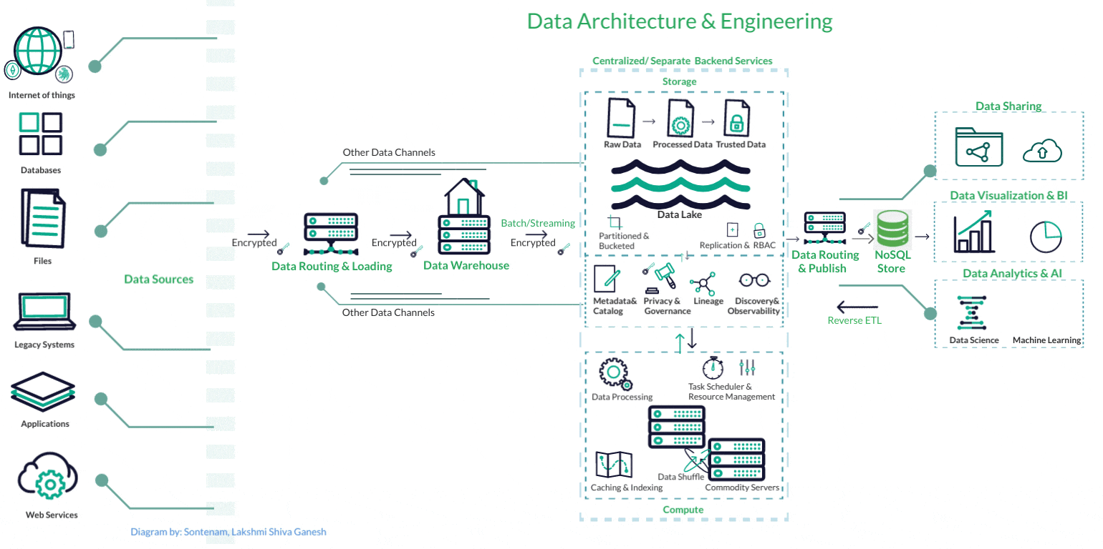
Notes:
https://d2lang.com/blog/animation/

Slide 3
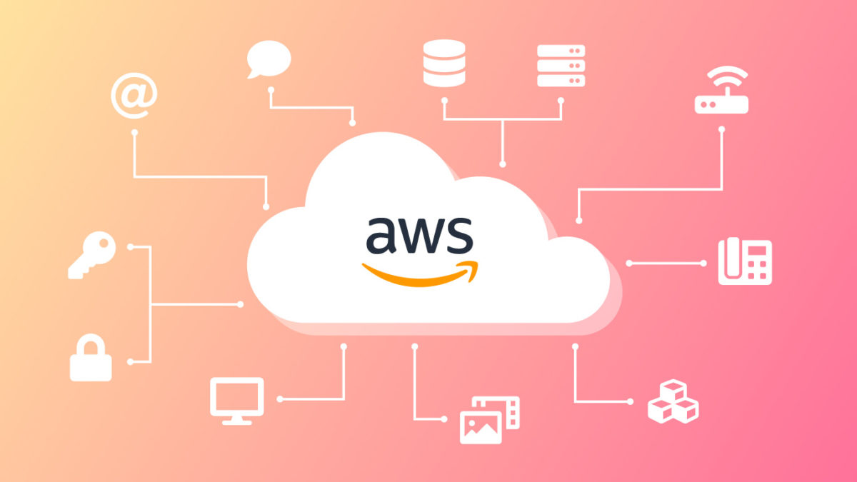
Notes:
https://www.softwaresennin.dev/blog/how-to-create-animated-gifs-for-aws-infrastructures

Slide 4
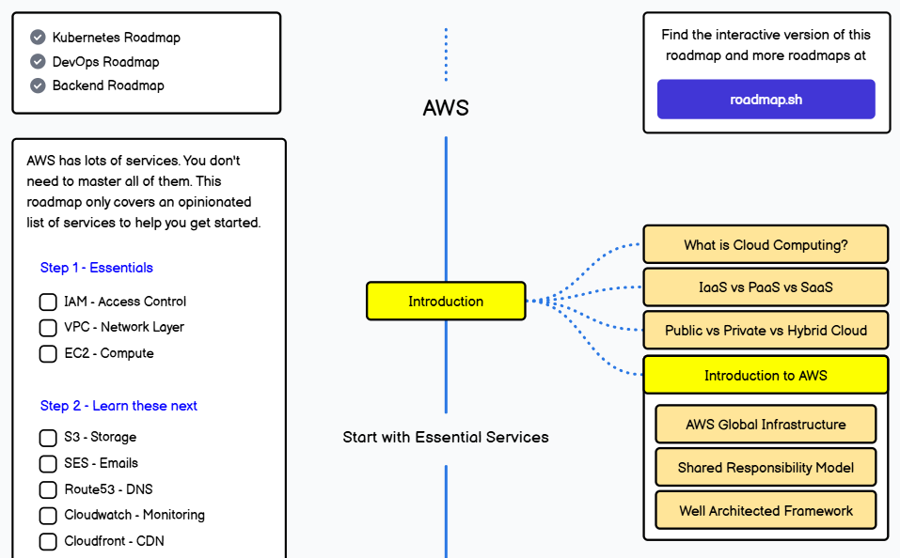
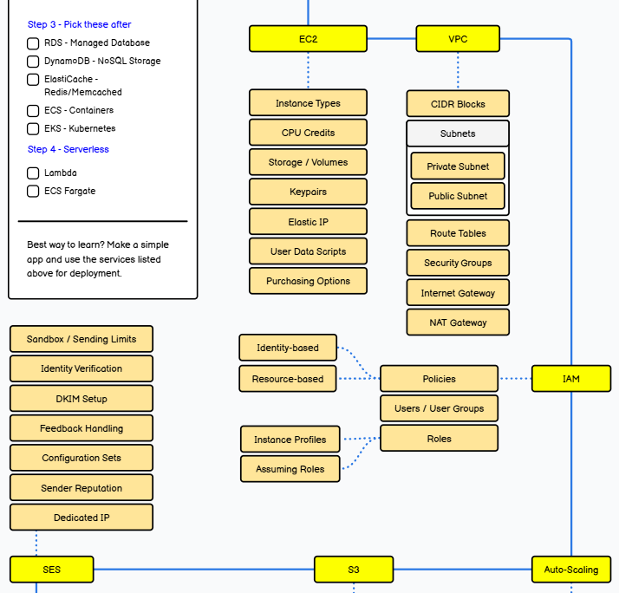
AWS Map
a
a
a1
a2
a3
Notes:
https://roadmap.sh/aws

Slide 5
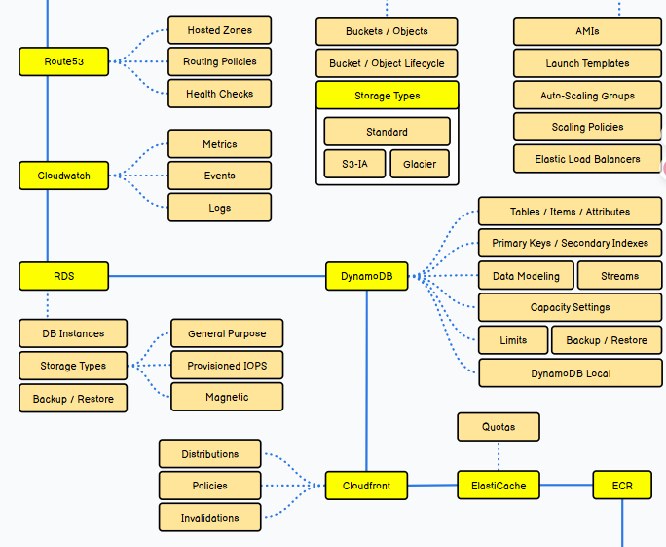
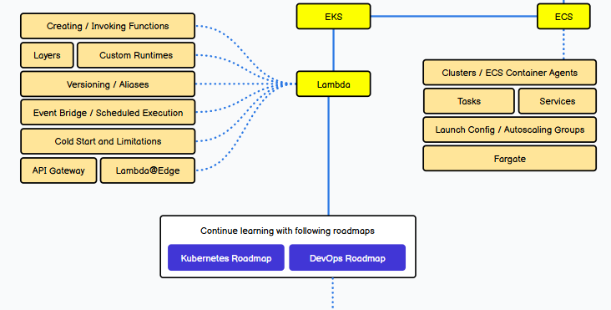
a1
a2
a3
b
b
Notes:
https://www.geeksforgeeks.org/blogs/aws-roadmap/
https://roadmap.sh/aws

Slide 6
Continue learning with :
Kubernetes Roadmap
DevOps Roadmap
Kubernetes Roadmap
Step by step guide to learning Kubernetes in 2025
DevOps Roadmap
Step by step guide for DevOps, SRE or any other Operations Role in 2025
https://roadmap.sh/aws
Continue learning with :
DevOps
Docker
Backend
Notes:
https://roadmap.sh/devops
https://www.geeksforgeeks.org/blogs/aws-roadmap/
https://roadmap.sh/aws

Slide 7
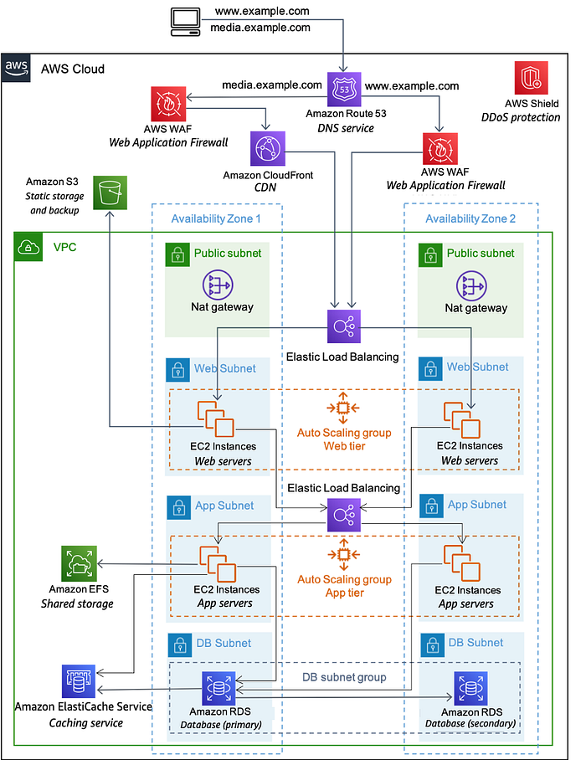
AWS Cloud Architecture
Amazon Route 53 is a web service provided by Amazon Web Services (AWS) that offers Domain Name System (DNS) services. DNS is a system that translates domain names (e.g., www.example.com) into IP addresses on the internet. Route 53 is used to provide domain name management and DNS services.
Some key features of Amazon Route 53 include:
1. Domain Name Management: Route 53 enables domain and subdomain management. You can create, edit, or delete domain name records.
2. High Availability: Route 53 utilizes AWS’s global infrastructure to provide high availability and low latency. This makes your websites and applications more reliable.
3. Fast DNS Resolution: Route 53 uses various optimization and caching techniques to speed up DNS resolutions. This allows you to achieve faster response times.
4. Robust Monitoring and Alerts: Route 53 offers health checks and monitoring services. This allows you to detect server or service outages and automatically perform traffic routing.
5. Elastic Routing and Load Balancing: Route 53 can be used for traffic routing and load balancing. For example, you can direct traffic to servers in different regions or perform load balancing.
6. Integration: It easily integrates with other AWS services. For instance, it can work seamlessly with services like AWS Elastic Beanstalk, Amazon S3, or AWS CloudFront.
Amazon Route 53 provides a reliable, fast, and scalable DNS solution for internet-based applications, websites, and other services.
Amazon CloudFront is a content delivery network (CDN) service offered by Amazon Web Services (AWS). A CDN is a technology that distributes content, data, and media files globally to provide users with faster and lower latency access. CloudFront aims to achieve this by hosting such content in local locations near users’ servers.
Some key features of Amazon CloudFront include:
1. High Performance: CloudFront accelerates web sites and applications by enabling users to access content more quickly.
2. Global Infrastructure: Leveraging AWS’s global network, CloudFront delivers content from different regions around the world, providing service from servers located near users.
3. Scalability: CloudFront enables scalable distribution of all types of content, including files, videos, images, and dynamic content.
4. Support for Dynamic and Static Content: CloudFront can distribute both static and dynamic content, making it suitable for websites and applications.
5. Security Features: CloudFront includes security measures such as HTTPS and origin security to ensure secure content distribution.
6. Data Analytics: CloudFront provides detailed analytics data to monitor user traffic and performance.
7. Custom Routing and Load Balancing: CloudFront offers customizable rules and routing policies for traffic distribution and load balancing.
8. Integration: It easily integrates with other AWS services. For instance, it can seamlessly work with services like Amazon S3 or Amazon EC2.
Amazon CloudFront offers a powerful solution for businesses, developers, and content providers aiming to enhance the speed and performance of content delivery.
Elastic Load Balancing (ELB) is a service provided by Amazon Web Services (AWS) used to automatically balance and direct traffic for distributed applications. ELB distributes user traffic among multiple Amazon EC2 instances or other targets to enhance the speed, resilience, and continuous operation of applications, with the goal of load balancing and high availability.
Key features of Amazon Elastic Load Balancing include:
1. Automatic Load Balancing: ELB automatically detects incoming traffic load and distributes it evenly among targets, reducing the load on each target.
2. High Availability: ELB monitors targets running in the background and detects any failures, automatically redirecting traffic to healthy targets. This ensures seamless application operation.
3. Flexibility: ELB offers flexible configuration options for different types of applications and targets. You can select load balancing methods that suit your application.
4. SSL Certificate Support: ELB provides capabilities to manage SSL (Secure Sockets Layer) certificates and enable secure communication over HTTPS traffic.
5. Monitoring and Analysis: ELB offers detailed statistics for monitoring and analyzing user traffic. This enables you to observe application performance and make improvements as needed.
6. Integration: ELB can be easily integrated with other AWS services. For example, it integrates with Amazon EC2 instances, Amazon RDS (Relational Database Service), and other services.
Elastic Load Balancing is a significant tool for businesses and application owners aiming to meet load balancing and high availability requirements.
AWS Shield is a protection service provided by Amazon Web Services (AWS) against Distributed Denial of Service (DDoS) attacks. DDoS attacks involve flooding a target with a massive amount of traffic from multiple devices or bots simultaneously, aiming to exhaust the target’s resources. Such attacks can overwhelm or render the target system unusable.
AWS Shield assists customers in safeguarding their AWS infrastructures from DDoS attacks and aims to minimize service disruptions. AWS Shield is offered in two different levels:
1. AWS Shield Standard: This service is automatically and freely provided to AWS customers. All customers using AWS infrastructure are inherently covered by this protection. AWS Shield Standard provides protection against common and straightforward DDoS attacks.
2. AWS Shield Advanced: This service offers additional layers of protection against more complex and large-scale DDoS attacks. AWS Shield Advanced is a subscription service that includes advanced protection, granular traffic analysis, and features such as 24/7 expert support for DDoS events.
AWS Shield is an effective solution for businesses and organizations to defend their online assets, websites, and applications against DDoS attacks.
Amazon ElastiCache is a service offered by Amazon Web Services (AWS) and it is a managed in-memory data storage solution designed to enhance the speed and scalability of your applications. ElastiCache uses RAM (random access memory) based cache servers to store frequently accessed data at high speeds, resulting in faster application performance.
Amazon ElastiCache can work with two main in-memory data storage engines:
1. Redis: Redis is a high-performance open-source in-memory data storage solution. It provides fast read and write operations and supports more complex data structures.
2. Memcached: Memcached is a simple and fast in-memory data storage solution. It primarily stores key-value pairs and is particularly suitable for basic data structures.
Key features of Amazon ElastiCache include:
Managed Service: ElastiCache offers the service of managing and operating the data storage infrastructure, eliminating the need for you to manage it yourself.
Performance Boost: High-speed caching results in faster application performance and an improved user experience.
Scalability: ElastiCache can increase or decrease cache size as needed, providing scalability.
Data Security: ElastiCache secures data with encryption and other security measures during storage and transmission.
Integration: ElastiCache can be easily integrated with other AWS services. For instance, integration with Amazon RDS (Relational Database Service) can be achieved.
Amazon ElastiCache is an excellent option for applications that require fast and scalable data storage solutions.
Amazon Relational Database Service (Amazon RDS) is a service provided by Amazon Web Services (AWS), offering a managed relational database server solution. Amazon RDS simplifies database management tasks, allowing application owners and developers to create, configure, and operate databases with less workload.
Amazon RDS can operate on the following popular relational database engines:
1. MySQL: An open-source relational database management system.
2. PostgreSQL: An open-source relational database management system.
3. Oracle Database: Oracle’s commercial relational database system.
4. Microsoft SQL Server: Microsoft’s relational database management system.
5. MariaDB: An open-source relational database management system, which is a fork of MySQL.
Key features of Amazon RDS include:
Managed Service: Amazon RDS automates the necessary tasks to manage and maintain the database server.
Scalability: Amazon RDS can scale the database size up or down as needed, allowing for scalability based on application requirements.
Backup and Restore: Amazon RDS ensures database security through automated backup and restore capabilities.
High Availability: Amazon RDS ensures continuous database operation through high availability modes and backup processes.
Security: Amazon RDS safeguards database access and data with security features like encryption.
Amazon RDS is a service that reduces the complexity of database management and makes database infrastructure more accessible.
Amazon Simple Storage Service (Amazon S3) is a storage service provided by Amazon Web Services (AWS). Amazon S3 offers users a reliable and scalable platform to store and manage data online. This service can be used to store files, database backups, archives, media files, and other data.
Key features of Amazon S3 include:
Data Storage: Amazon S3 stores data in blocks and can be used to store all types of files.
High Scalability: Amazon S3 is designed to store and access very large amounts of data, making it capable of handling data growth.
High Availability: Amazon S3 includes features like multi-region and cross-region replication to ensure high availability and durability.
Data Security: Amazon S3 secures data with encryption during storage and transmission, along with access controls.
Data Management: Amazon S3 offers data management capabilities such as querying, editing, and organizing data, in addition to storage.
Pay-As-You-Go Model: Amazon S3 allows users to pay based on the amount of storage they use.
Integration: Amazon S3 can be easily integrated with other AWS services and applications.
Amazon S3 is a widely used service across various industries, catering to diverse data storage needs.
Notes:
https://medium.com/@eyupcebe/aws-cloud-architecture-8ea9a99fe8fa
https://medium.com/@eyupcebe/aws-cloud-architecture-8ea9a99fe8fa
https://www.geeksforgeeks.org/blogs/aws-roadmap/

Slide 8
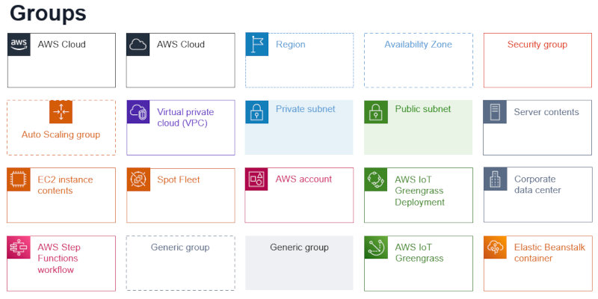
AWS
The Software Architect Elevator
Notes:
https://architectelevator.com/cloud/iac-architecture-as-code/

Slide 9
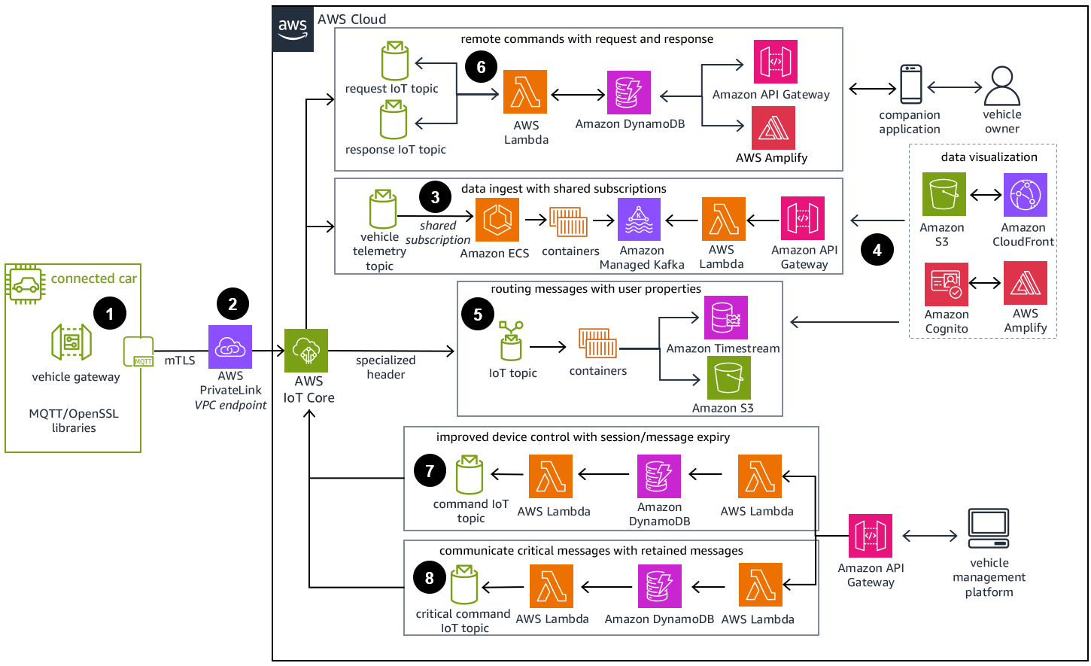
AWS

Slide 10
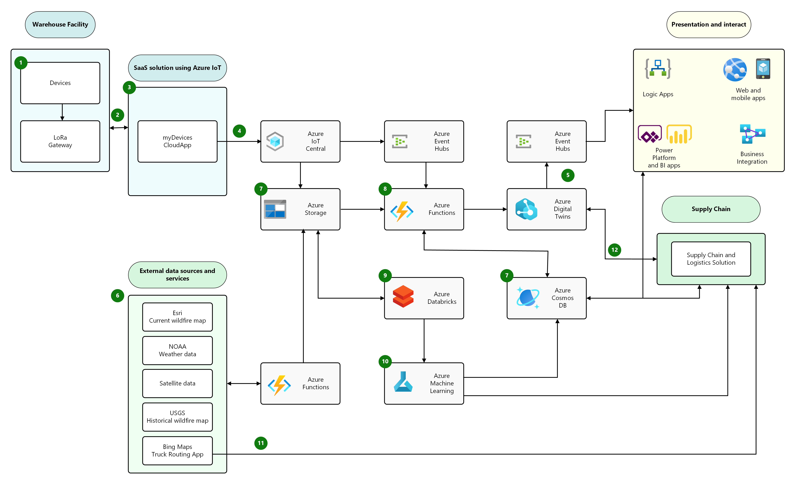
AWS
Notes:
https://architectelevator.com/cloud/iac-architecture-as-code/

Slide 11
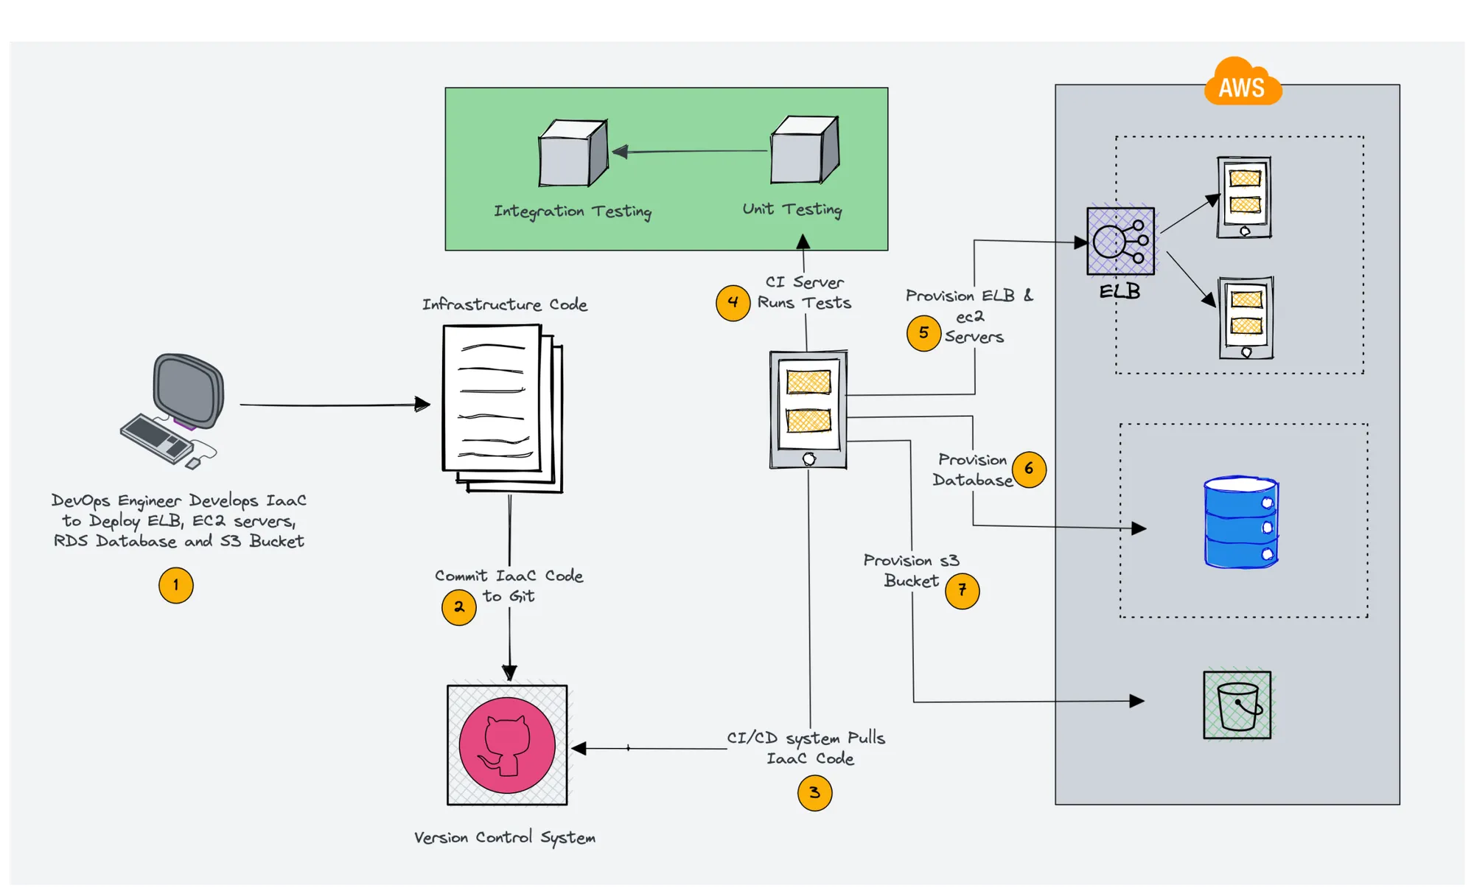
AWS
Infrastructure standpoint before moving on to the key concepts.
Infrastructure: Infrastructure refers to the combination of hardware and software components that make up the IT environment, such as servers, storage, network devices, firewall devices, routers, and more.
Provisioning: In IT, provisioning is the process of creating infrastructure and making it available to end users.
Configuration: It is the process of configuring the provisioned IT infrastructure resources. For example, installing and configuring a database on a server or configuring network and firewall settings.
Automation: It is the process of automating infrastructure tasks, such as automating the installation of software packages, setting up users and permissions, or configuring network devices.
Orchestration: Orchestration is the process of coordinating multiple automation tasks. The output from one automation task can be used as input for another, allowing for a more complex and streamlined workflow. For example, to deploy a server, you may first need to provision network resources, and then use the output from that automation (network details) to deploy the server.
Notes:
What is Infrastructure as code?
What is infrastructure provisioning and
What is configuration management?
https://devopscube.com/infrastructure-as-code-configuration-management/
infrastructure standpoint before moving on to the key concepts.
Infrastructure: Infrastructure refers to the combination of hardware and software components that make up the IT environment, such as servers, storage, network devices, firewall devices, routers, and more.
Provisioning: In IT, provisioning is the process of creating infrastructure and making it available to end users.
Configuration: It is the process of configuring the provisioned IT infrastructure resources. For example, installing and configuring a database on a server or configuring network and firewall settings.
Automation: It is the process of automating infrastructure tasks, such as automating the installation of software packages, setting up users and permissions, or configuring network devices.
Orchestration: Orchestration is the process of coordinating multiple automation tasks. The output from one automation task can be used as input for another, allowing for a more complex and streamlined workflow. For example, to deploy a server, you may first need to provision network resources, and then use the output from that automation (network details) to deploy the server.

Slide 12
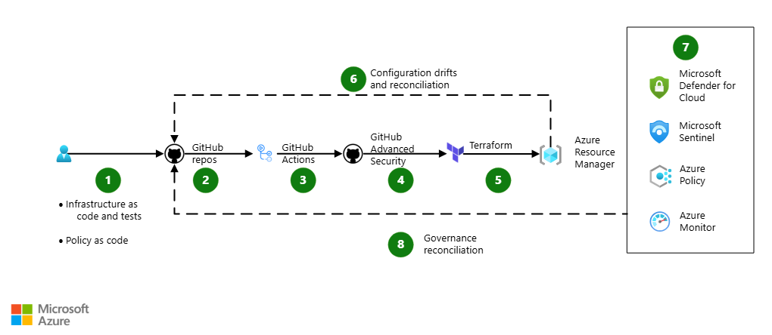
Azure DevSecOps for infrastructure as code (IaC)
Notes:
The following dataflow corresponds to the previous diagram:
Use test-driven development to check code changes for infrastructure definitions, like IaC templates, into GitHub repositories. You develop unit tests, integration tests, and policy as code (PaC) at the same time to test the quality of the IaC.
Pull requests trigger automated unit testing through GitHub Actions.
Configure the GitHub Actions workflow process to test the IaC by using locally deployed infrastructure states and plans.
Configure GitHub Actions to scan for code quality and security problems. Create your own custom-built GitHub CodeQL queries to analyze IaC templates and detect potential security vulnerabilities. If a vulnerability is detected, GitHub sends alerts to the organization or to repository owners and maintainers.
The IaC tool provisions and modifies resources for each environment by tailoring size, instance count, and other properties. You can run automated integration tests for IaC on provisioned resources.
When a manual update to the infrastructure is necessary, the designated administrator access is elevated to perform the modifications. After modification, the elevated access is removed. You should also log a GitHub Issue for reconciliation of the IaC. The reconciliation steps and approaches depend on the specific IaC tools.
SecOps continuously monitors and defends against security threats and vulnerabilities. Azure Policy enforces cloud governance.
When an anomaly is detected, a GitHub Issue is automatically logged so that it can be resolved.
Components
GitHub is a code-hosting platform for version control and collaboration. A GitHub source-control repository contains all project files and their revision history. Developers can work together to contribute, discuss, and manage code in the repository.
GitHub Actions provides a suite of build and release workflows that covers continuous integration, automated testing, and container deployments.
GitHub Advanced Security provides features to secure your IaC. It requires another license.
CodeQL provides security scanning tools that run on static code to detect infrastructure misconfigurations.
Terraform is a partner product developed by HashiCorp that allows infrastructure automation on Azure and other environments.
Microsoft Defender for Cloud provides unified security management and advanced threat protection across hybrid cloud workloads.
Microsoft Sentinel is a cloud-native security information and event management (SIEM) and security orchestration automated response (SOAR) solution. It uses advanced AI and security analytics to help you detect and respond to threats across your enterprise.
Azure Policy helps teams manage and prevent IT problems by using policy definitions that can enforce rules for cloud resources. For example, if your project is about to deploy a virtual machine that has an unrecognized SKU, Azure Policy alerts you to the problem and stops the deployment.
Azure Monitor collects and analyzes app telemetry, such as performance metrics and activity logs. When this service identifies irregular conditions, it alerts apps and personnel.
https://learn.microsoft.com/en-us/azure/architecture/solution-ideas/articles/devsecops-infrastructure-as-code
https://www.openstack.org/software/
https://docs.openstack.org/liberty/install-guide-rdo/overview.html

Slide 13
Amazon Web Services
PDS

Slide 14
History: The early days
Cloud computing: A new term for a concept that has been around since the 1960s
Who invented it?
No agreement. Some candidates:
John McCarthy (Stanford professor and inventor of Lisp; proposed the 'service bureau' model in 1961)
J.C.R. Licklider (contributed key ideas to ARPANET; published a memo on the "Intergalactic Computer Network" in 1963)
Douglas Parkhill (published a book on "The Challenge of the Computer Utility" in 1966)

Slide 15
History: Becoming a cloud provider
Technology | Cost in medium DC (~1,000 servers) | Cost in large DC (~50,000 servers) | Ratio
Network | $95 per Mbit/sec/month | $13 per Mbit/sec/month | 7.1
Storage | $2.20 per GByte/month | $0.40 per GByte/month | 5.7
Administration | ~140 servers/admin | >1,000 servers/admin | 7.1
Source: James Hamilton's Keynote, LADIS 2008
Early 2000s: Phenomenal growth of web services
Many large Internet companies deploy huge data centers, develop scalable software infrastructure to run them
Due to economies of scale, these companies were now able to run computation very cheaply
What else can we do with this?

Slide 16
History: Incentives
Idea: Use your existing data center to provide cloud services
Why is this a good idea?
Make a lot of money
Price advantage of 3x-7x → Can offer services much cheaper than medium-size company and still make profit
Leverage existing investment
New revenue stream at low incremental cost (example: many Amazon AWS technologies were initially developed for Amazon's internal operations)
Defend a franchise
Example: Microsoft enterprise + development apps → Microsoft Azure

Slide 17
History: Incentives (continued)
Attack an incumbent
Company with requisite datacenter may want to establish a 'beach head' before a '800 pound gorilla' emerges
Leverage existing customer relationships
IT service organizations like IBM Global Services have extensive customer relationships; provide anxiety-free migration path to existing customers
Become a platform
Example: Facebook's initiative to enable plug-in applications is a great fit for cloud computing

Slide 18
History: The pioneers
Jul 2002: Amazon Web Services launched
Third-party sites can search and display products from Amazon's web site, add items to Amazon shopping carts
Available through XML and SOAP
Mar 2006: Amazon S3 launched
Innovative 'pay-per-use' pricing model, which is now the standard in cloud computing
Cheaper than many small/medium storage solutions: $0.15/GB/month of storage, $0.20/GB/month for traffic
Amazon no longer a pure retailer, entering technology space
Aug 2006: EC2 launched
Core computing infrastructure becomes available

Slide 19
History: Wide-spread adoption
Apr 2008: Google App Engine launched
Same building blocks Google uses for its own applications: Bigtable and GFS for storage, automatic scaling and load balancing, ...
Nov 2009: Windows Azure Beta launched
Becomes generally available in 21 countries in Feb 2010
Microsoft’s online services are gradually transitioning to Azure
Dec 2013: Google Compute Engine launched
Provides lower level support vs. App Engine, gives full set of services
Dramatically lower prices, quickly matched by AWS and Azure

Slide 20
One Set of Cloud Services: Amazon Web Services

Slide 21
Why Amazon AWS and not ?
Insert your favorite cloud here
Amazon is only one of several cloud providers
Others include Microsoft Azure, Google Cloud...
There is no common standard (yet)
Initially, MS and Google supported PaaS (.NET and Java, resp.)
Gradually each has grown to support both IaaS and PaaS
AWS is PaaS/IaaS with a broad menu of choices
So we had to pick one specific provider
Amazon AWS is going to be used for the rest of this class
Amazon's only involvement is providing free AWS cycles/storage
Everything we do on AWS has an equivalent on Azure and GC

Slide 22
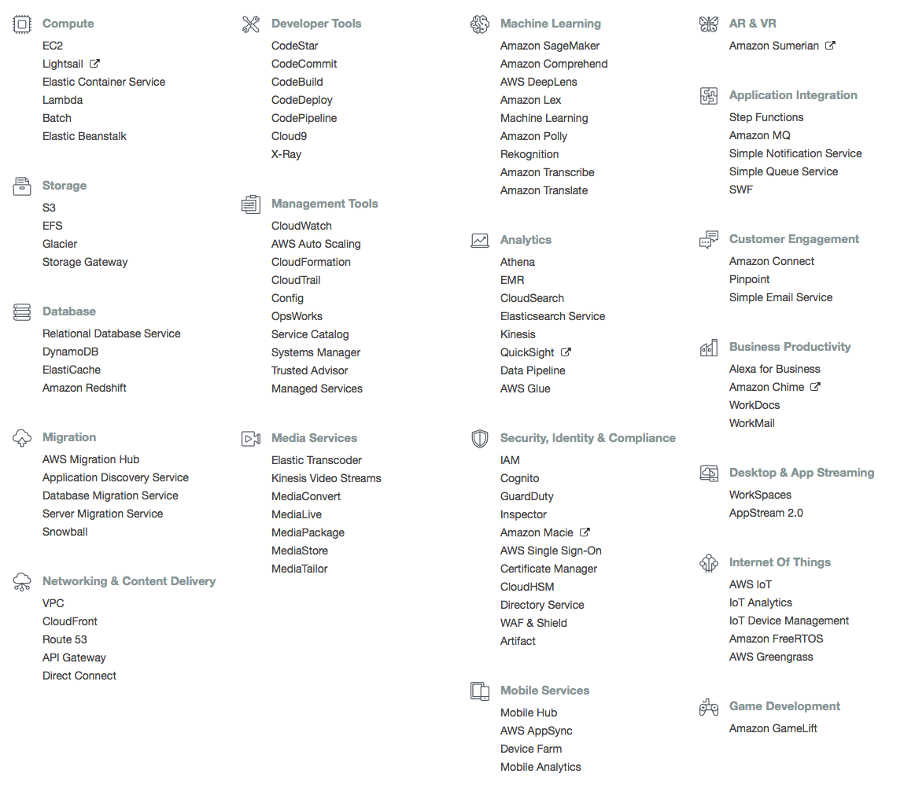
What is AWS?

Slide 23
Categories of Functionality
Compute
Storage
Database
Migration
Networking and Content Delivery
Developer Tools
Management Tools
Media Services
Machine Learning
Analytics
Security, Identity, Compliance
Mobile Services
AR & VR
Application Integration
Customer Engagement
Business Productivity
Desktops and App Streaming
Internet of Things
Game Development

Slide 24
Application Architectures
Many ways to combine data with code to get something done:
Mainframe computer running monolithic code with dumb terminals
Real time functionality (CRUD = Create, Retrieve, Update, Delete)
Batch functionality (Jobs, schedulers, reporting, etc)
Client/Server (2 Tier)
Windows (thick) client server backend
Different machines
Variant was thin client
Client/Server (3 Tier)
Separation of client code from business logic from data
Business logic could go into the database
Communication TCP, REST

Slide 25
Application Architectures
Web Architecture
Browser with varying degrees of client functionality (HTML5, Javascript, CSS3)
Web server with UI and Business Logic and Databases
This still can incorporate background tasks and services
Communication, HTTP, REST
Service Oriented Architectures
Business and data separated out into services
Communication REST, Message Queues

Slide 26
Running code
Once you have an architecture, it may be deployed in many ways:
Virtual Machine (EC2 Instance) – basically a server running Windows or Linux
Containers – Virtual Environments running on a Virtual Machine
Serverless environments
Cloud platforms let you choose the resources you need suited to your execution requirements
Pros: Flexible, inexpensive
Cons: Choice is overwhelming

Slide 27
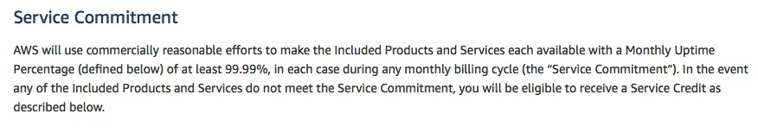
Service Level Agreement
53 min downtime per year allowed
http://aws.amazon.com/ec2-sla/ (12/02/2018; excerpt)

Slide 28
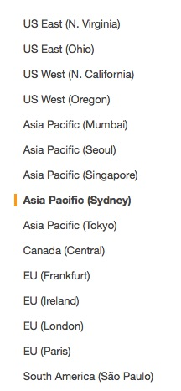
AWS Regions
Resources on AWS split into geographic regions
Provides for data sovereignty concerns
Resources are priced differently
Mostly there for simple latency
Each region has multiple Availability Zones
Independent failure domains
Zones within a region that are networked with low-latency connections
Eg ap-southeast-2a, ap-southeast-2b

Slide 29
EC2 (Elastic Compute Cloud)
Virtual machines running on a hypervisor
Virtual machines based on:
Amazon Machine Image (AMI) – OS, default software, configuration, virtualization type
Instance type
vCPU (number of threads of hyperthreaded CPUs)
Memory (quantity)
Instance Storage (type and quantity)
Network performance
IPv6 support

Slide 30
EC2 Instance Configuration
Spot instance or On-Demand or Reserved
Network configuration
VPC
Static IPs
Identity Access Management (IAM) Role
Shutdown behavior
Monitoring
Tenancy
Storage (Elastic Block Storage)

Slide 31
EC2 Instances
Spot instance: pay by the hour – price varies depends on demand
On-Demand: pay by the hour but price is fixed
Reserved: pay by the year – lower fixed price
Instance Types:
General Purpose (T, M)
Compute Optimized (C)
Memory Optimized (X, R)
Accelerated Computing (P, F)
Storage Optimized (H, I, D)

Slide 32
EC2 Instances
Type | vCPU | RAM (GiB) | Storage (GB) | Networking Performance | Physical Processor | Clock Speed (GHz) | Intel AVX | Intel AVX2 | Intel Turbo | EBS OPT | Enhanced Networking
t2.nano | 1 | 0.5 | EBS Only | Low | Intel Xeon family | up to 3.3 | Yes | - | Yes | - | -
C5.large | 2 | 4 | EBS Only | Up to 10 Gbps | Intel Xeon Platinum | 3.0 | Yes | Yes | Yes | Yes | Yes
x1.16xLarge | 64 | 976 | SSD | 10 Gbps | Intel Xeon E7-8880 v3 | 2.3 | Yes | Yes | Yes | Yes | Yes

Slide 33



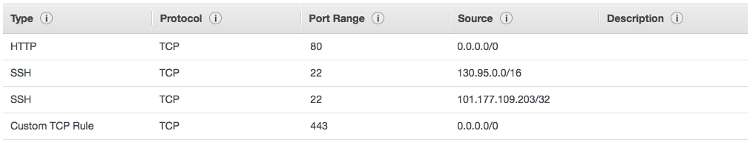
EC2 Security
No
Security Group
Firewall
Configure ssh access
Generate Public/Private Key Pairs
Yes
Instance

Slide 34
Recap: EC2
What EC2 is:
IaaS service - you can rent virtual machines
Various types: Very small to very powerful
How to use EC2:
Ephemeral state - local data is lost when instance terminates
AMIs - used to initialize an instance (OS, applications, ...)
Security groups - "firewalls" for your instances
Regions and availability zones
On-demand/reserved/spot instances
Service level agreement (SLA)

Slide 35
EBS Volumes
EBS storage is allocated in volumes
A volume is a 'virtual disk' (size: 1GB - 1TB)
Basically, a raw block device
Can be attached to an instance (but only one at a time)
A single instance can access multiple volumes
Placed in specific availability zones
Why is this useful?
Be sure to place it near instances (otherwise can't attach)
Replicated across multiple servers
Data is not lost if a single server fails
Amazon: Availability is 99.999% (5 mins downtime a year) and a failure rate of 0.1 – 0.2% a year (20 times more reliable than standard disks)

Slide 36
EBS Continued
Automatically apply encryption
Snapshot – create a copy of the EBS volume(s) to recreate at any time
Elastic Volumes – can increase size automatically without using a snapshot
Underlying technology is SSD or HDD
SSD better for disk intensive applications
EBS-Optimized – guarantees certain levels (provisioned IOPS) of throughput (500 and 10,000 Mbps) (SATA drive around 5,000 Mbps)

